Slide 1
Simple Linear Regression and Correlation

Slide 2
Introduction
We will examine the relationship between x(independent variable) and y(dependent variable) via a mathematical equation.
The motivation for using the technique:
Forecast the value of a dependent variable (y) from the quantitative variables x value of independent variables (x₁, x₂,…x_{k}.).
Analyze the specific relationships between the independent variables and the dependent variable.

Slide 3
The Simple Linear Regression Model
The first order linear model
y = dependent variable
x = independent variable
β₀ = y-intercept
β₁ = slope of the line
ε = error variable
β₀ and β₁ are unknown population parameters, therefore are estimated
from the data.
y
Β₁
β₀
x

Slide 4

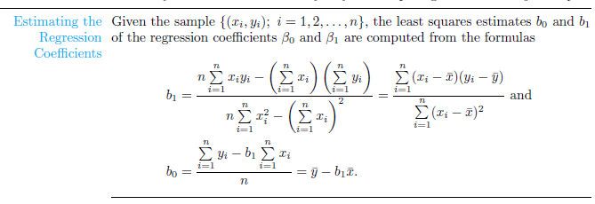
Linear Regression
The regression equation that estimates the equation of the first order linear model is:

Slide 5
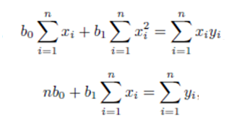
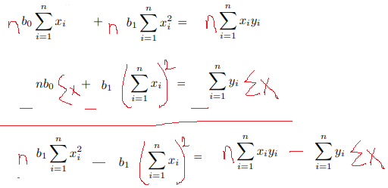

Slide 7
Linear Regression
The regression equation that estimates the equation of the first order linear model is:

Slide 8
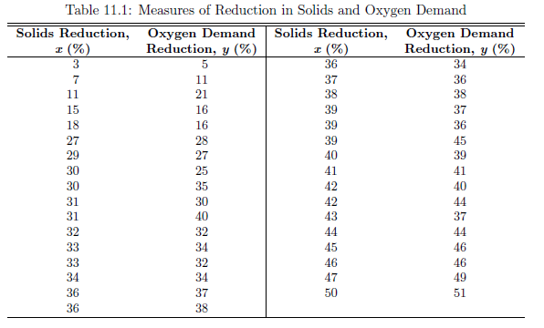
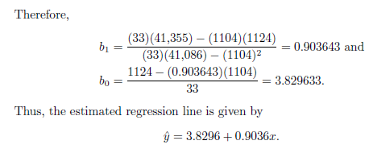
Estimate the regression line for the pollution data of Table 11.1.

Slide 9
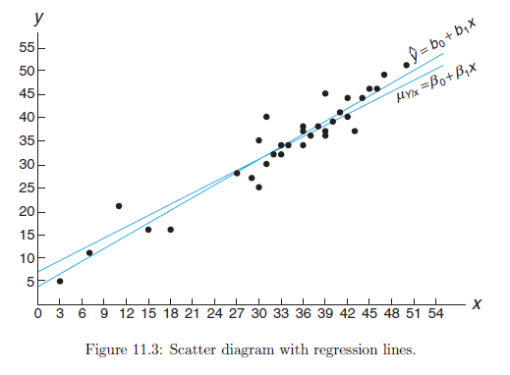

Slide 10
Correlation
Measures the relative strength of the linear relationship between two variables
Ranges between –1 and 1
The closer to –1, the stronger the negative linear relationship
The closer to 1, the stronger the positive linear relationship
The closer to 0, the weaker any positive linear relationship

Slide 11
Scatter Plots of Data with Various Correlation Coefficients
Y
Y
Y
X
X
X
r = -1
r = -.6
r = 0
Y
Y
Y
X
X
X
r = +1
r = +.3
r = 0
Slide from: Statistics for Managers Using Microsoft® Excel 4th Edition, 2004 Prentice-Hall

Slide 12
Correlation

Slide 13
Assignment
11.2
11.3 a,c
11.5 a
11.11 b
11.12
11.43
11.44 a
11.53 a

